Slide 1
Environmental Science 101
Melissa Miller

Slide 2
About Myself
I am an Environmental Science Major
I got involved with my major because I am part Native American, and I have enjoyed nature my whole life
I love to go swimming, going for walks, mushroom picking and I have a house up in the country
Recently joined the Arborteum Advocates

Slide 3
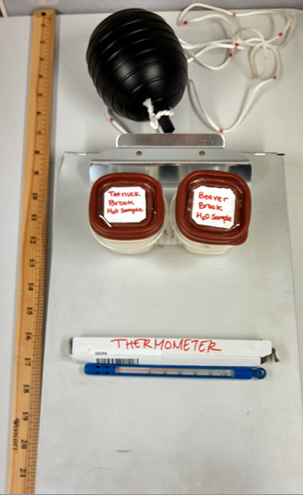
Water Sampling
Equipment

Slide 5
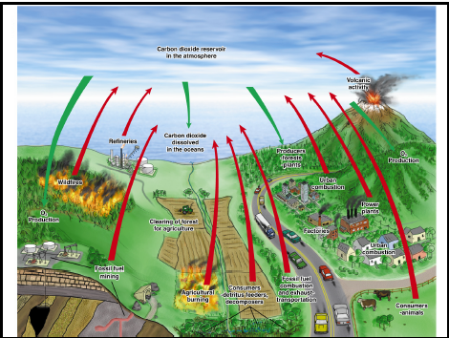
Carbon Fixation

Slide 6
Electromagnetic Energy

Slide 7
Climate Change
Increased levels of Carbon Dioxide into our atmosphere which also increases the temperature
Ocean is becoming more acidic, so in other the pH is lowered
Many species are becoming endangered
Trees are being cut down that release carbon into our atmosphere

Slide 8
Habitat destruction
Sad face ☹

Slide 9
Invasive Species
Vine from Asia invading North America

Slide 10
Killing of Animals
Rhinos are very territorial creatures

Slide 11
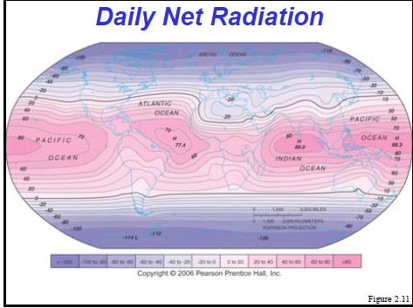
Daily Net Radiation
Can you guess which place is hotter?

Slide 12
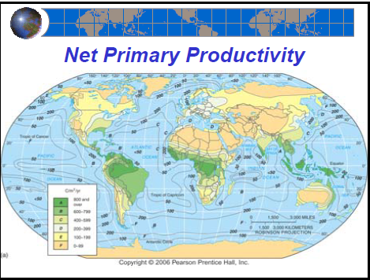
Net Primary Productivity
Notice anything similar to slide 8

Slide 13
Videos
https://www.youtube.com/watch?v=b-h-Kg9oo2I
http://www.youtube.com/watch?v=rQpneJ-F00Q
http://www.youtube.com/watch?v=2kBTRg3wPIw
https://www.youtube.com/watch?v=v0bVu9KZse0

Slide 14
Atmosphere

Slide 15
Atmosphere Function

Slide 17
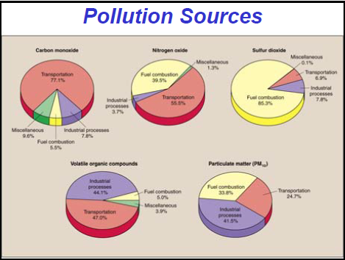
Pollution in our Atmosphere
The compounds that affect our atmosphere

Slide 18
Water Cycle
Water is also stored in Aquaifers over time

Slide 19
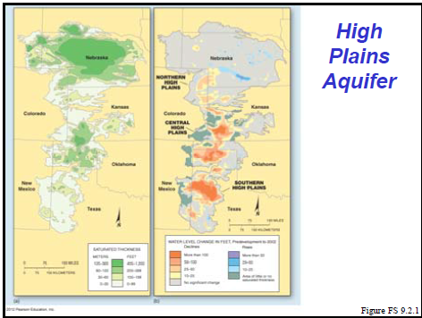
Aquifer

Slide 20
How the world uses water
Why?

Slide 21
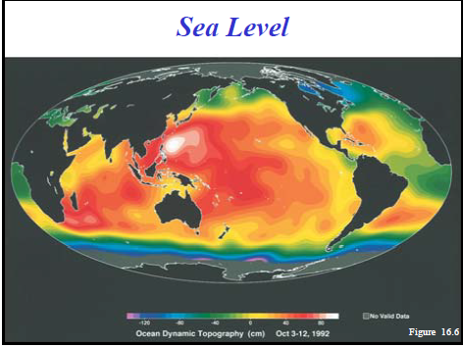
One issue with our Ocean

Slide 22
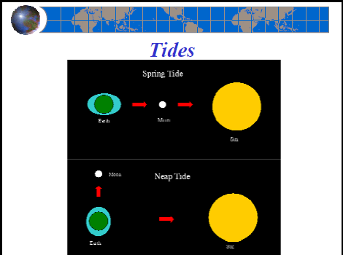
Different Tides

Slide 23
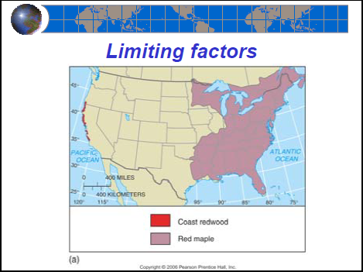
Trees

Slide 24
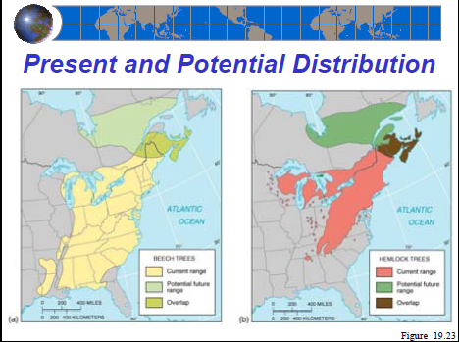
Trees Cont.

Slide 25
Another Invasive Problem

Slide 26
Interesting Fact

Slide 27
Another Interesting Fact

Slide 28
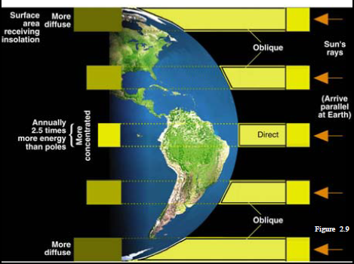
Insolation: Pathways include scattering, refraction, reflection, absorbtion and transmission

Slide 29
Crustal Formation
Earthquakes are formed by either ocean-ocean collisions, land-ocean collisions, and land-land collisions cause mountains to form

Slide 30
The Nitrogen Cycle

Slide 31
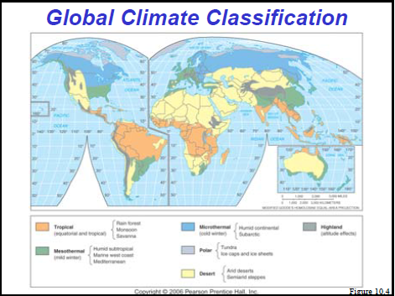
Global Climate Classification

Slide 32
More Information
NOAA (National Oceanic Atmospheric Administration)
EDF (Environmental Defense Fund)
EPA (Environmental Protection Agency)
Volunteer at your local park, or wildlife refugee
Write letters to state or government officials

